Slide 1
Factory address :
No .109,7th cross,
bedrapalli road,
kamarajar nagar,
Hosur -635126

Slide 2
OUR ORGANISATION UNITS
1.MANUFACTURING UNITS
2.DESIGN UNIT
3.GAUGES ASSEMBLY UNIT
4. FABRICATION UNIT

Slide 12
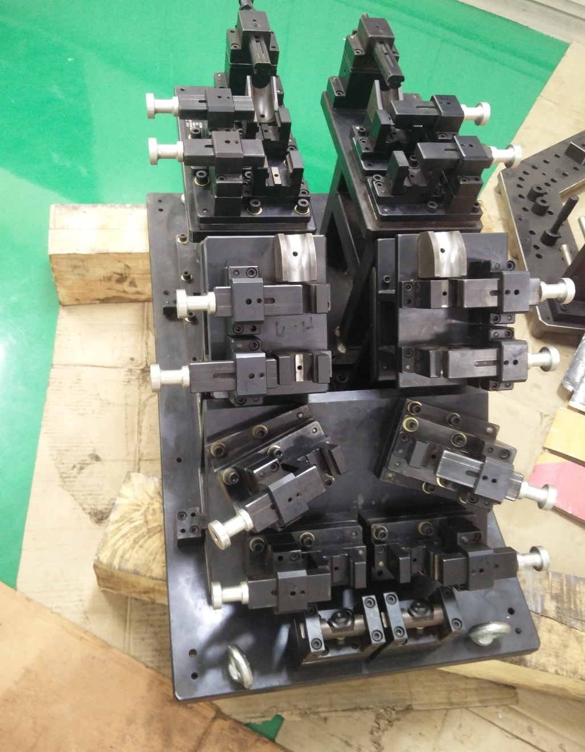
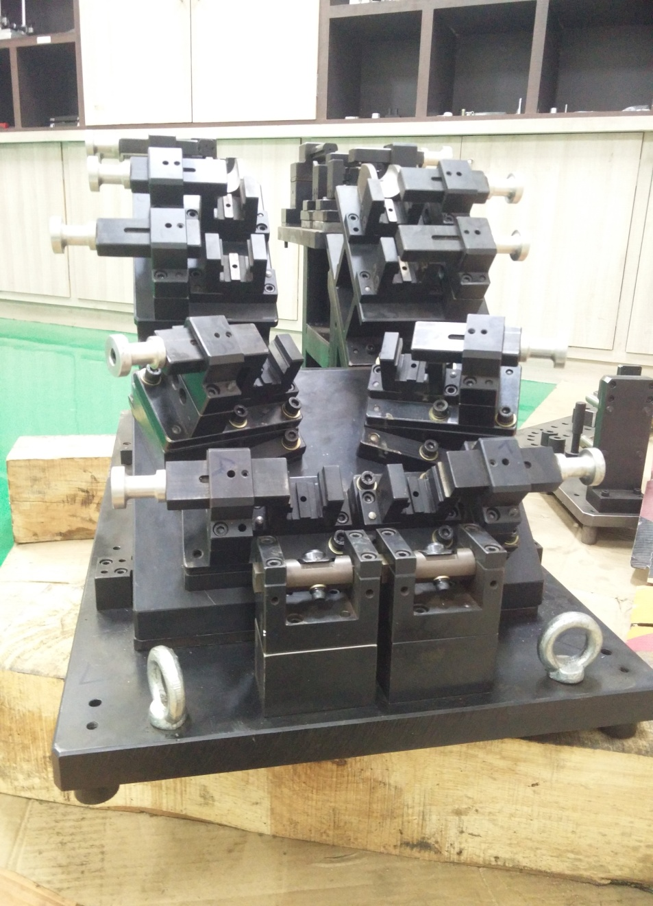

Slide 13
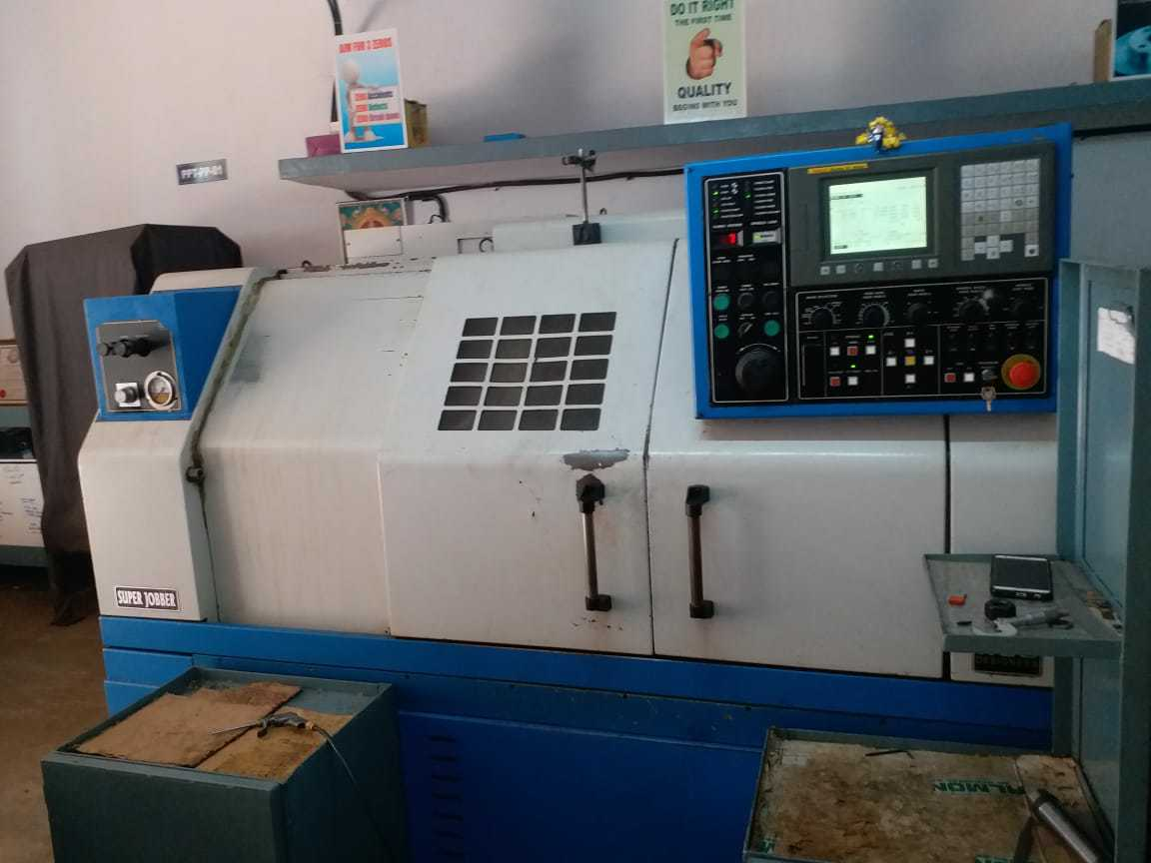
CNC MACHINE

Slide 14
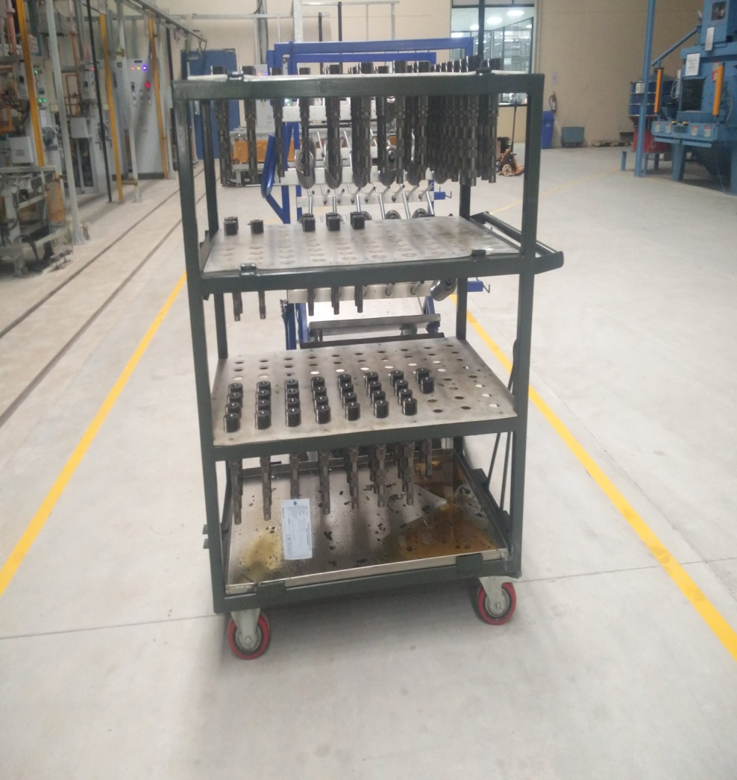
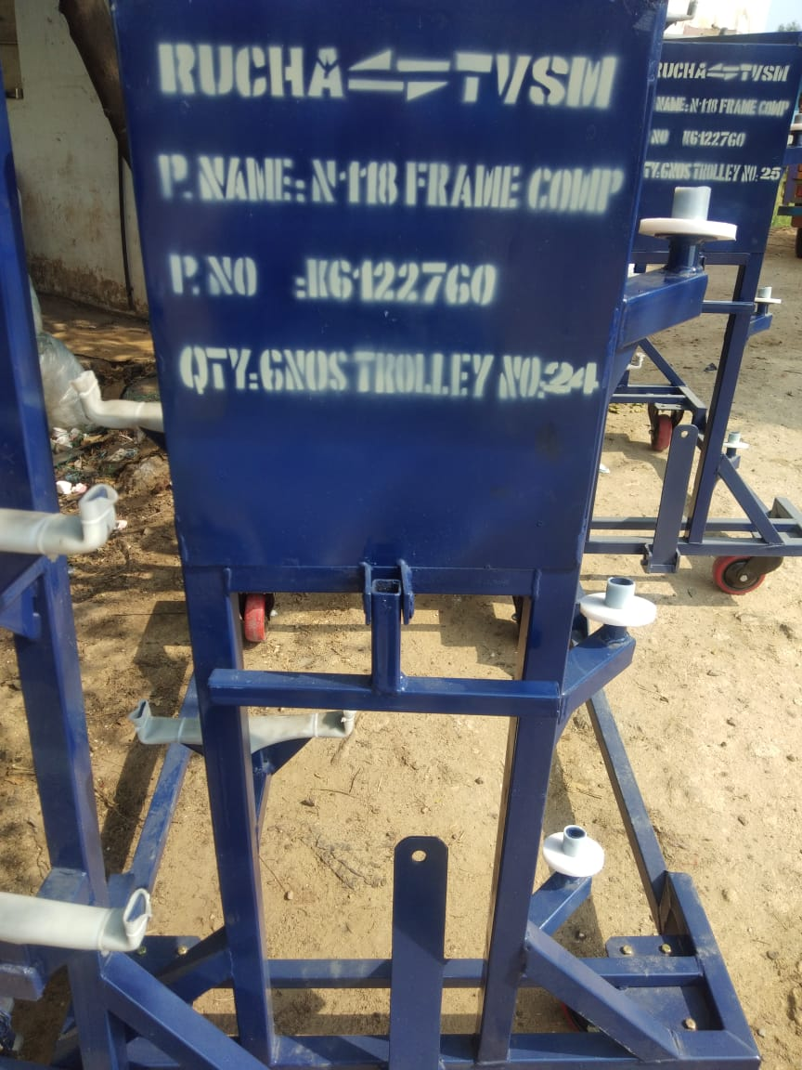
FABRICATION

Slide 15
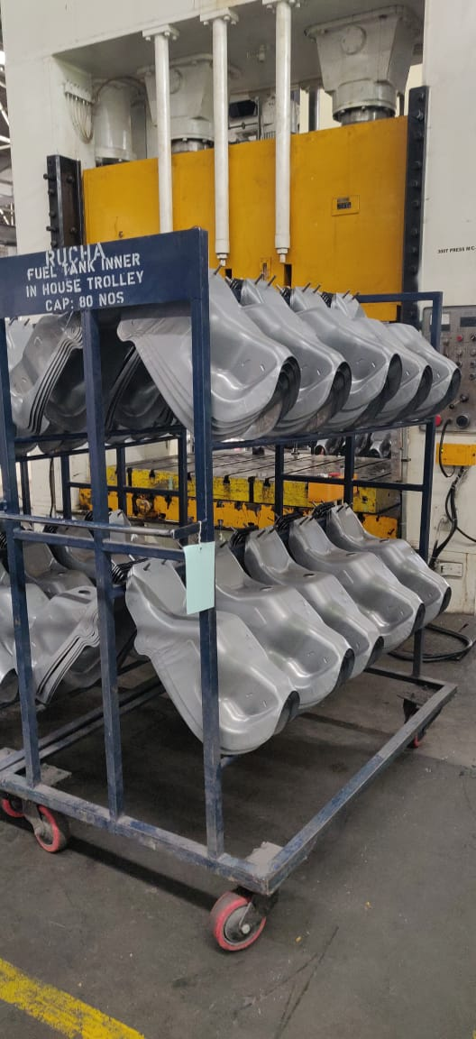
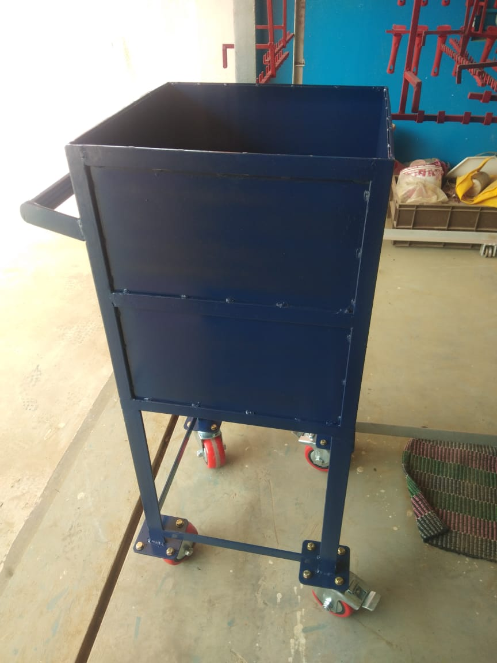
TROLLEY
MATERIAL STORAGE BIN

Slide 19
Our valuable customers

Slide 20
MEASUREMENTS LIST
INSTRUMENTS | MAKE | SPECIFICATION
HEIGHT MASTER | MITUTOYO | 900MM
DIGITAL VERNIER CALIPER | MITUTOYO | 200MM
DIAL WITH DIAL STAND | MITUTOYO | 2-MICRON
MICROMETER | MITUTOYO | 0.25MM,35 -50 &50-75
HEIGHT MASTER MANUAL | MITUTOYO | 300MM
SURFACE PLATE | GMT | 1000*1000

